Slide 1
Presentation Kilkenny
Transition Year Programme

Slide 2
Overview
One Year Programme taken after Junior Cycle before the two-year Leaving Certificate Programme
Designed to act as a bridge between J.C. & L.C. programmes
Optional for students
Programme is designed by the school to suit the needs & interests of its students
No State Examination
Assessment is carried out on an ongoing basis
Ran by a Core Team
Transition Year Programme

Slide 4
Mission Statement
“to promote the personal, social, educational and vocational development of pupils and to prepare them for their role as autonomous, participative and responsible members of society”
(The Department of Education Transition Year Guidelines, 1995)

Slide 5
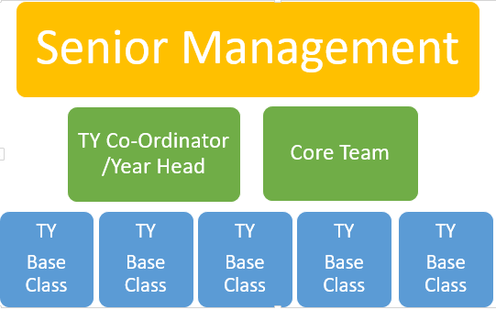
TY Programme Structure

Slide 6
SUBJECTS

Slide 7
Core Subjects
Irish
English
Maths
French/Spanish
Religion
PE
Information Technology
Tutor Group
SPHE/Career Guidance
Transition Year Programme

Slide 8
L.C. Subject Sampling Subjects
Chemistry
Biology
Physics
Agricultural Science
Physical Education
Home Economics
Art
Music
History
Geography
Business
Economics
Accounting
Enterprise
Transition Year Programme

Slide 9
Transition Year
Modules
Junk Kouture
Podcasting
Public Access to Law
Coding
Politics
GAA Future Leaders
Debating
Mini Company
Digital Media
Computer Science
usiness
Economics
Accounting
Applied Maths
Transition Year Programme

Slide 10
Activities Overview

Slide 11
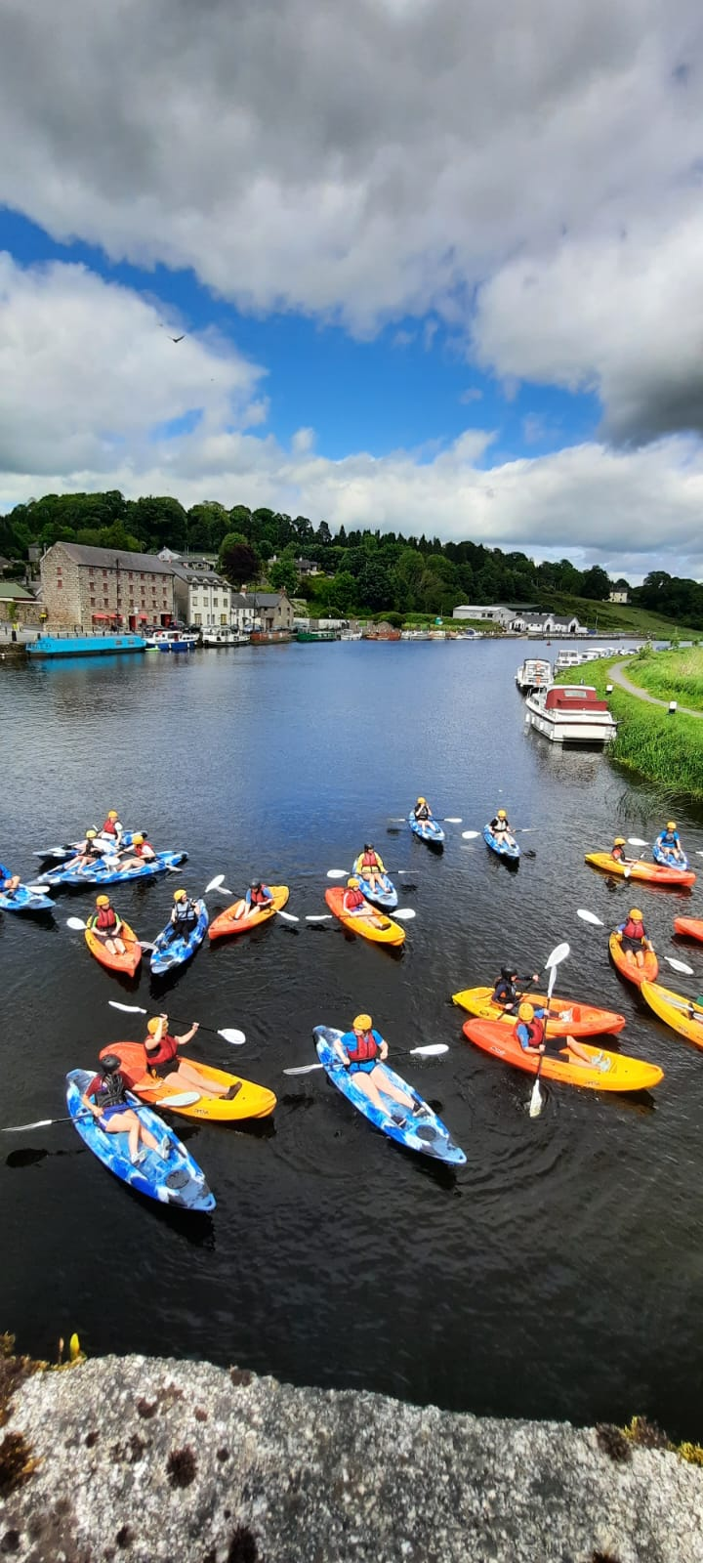
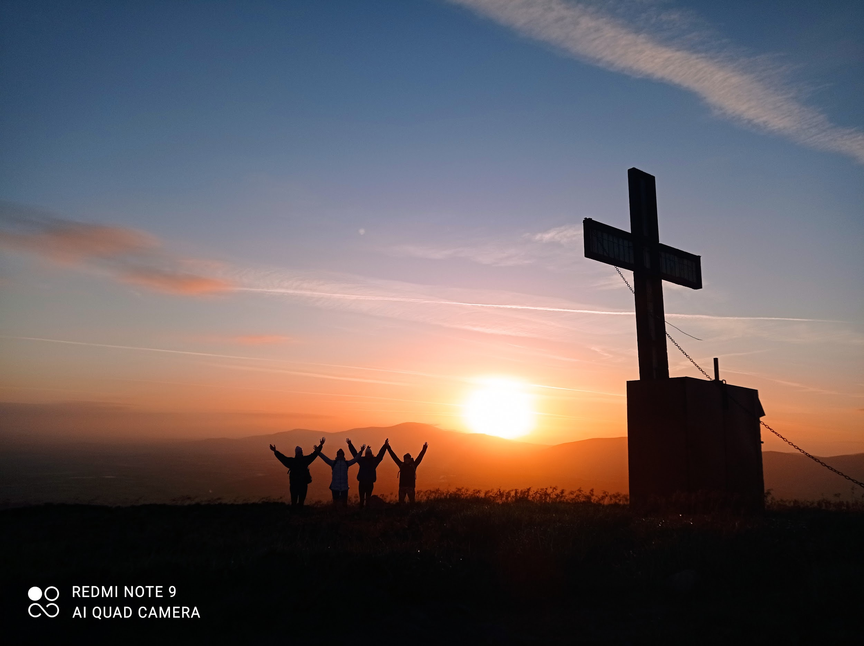
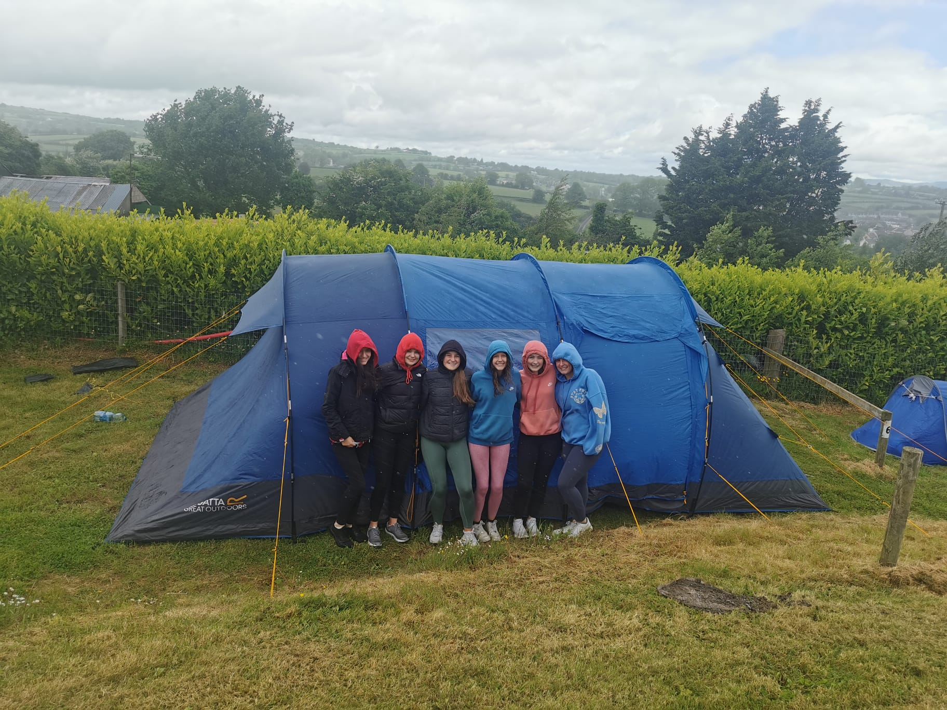
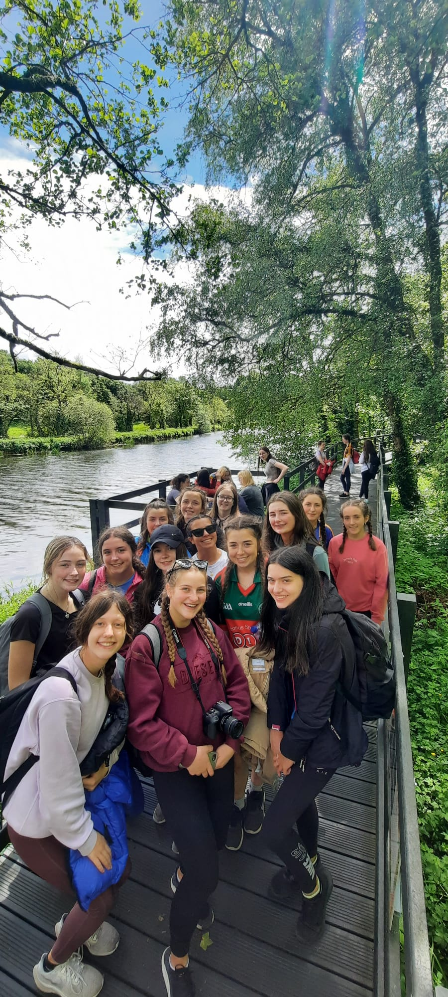
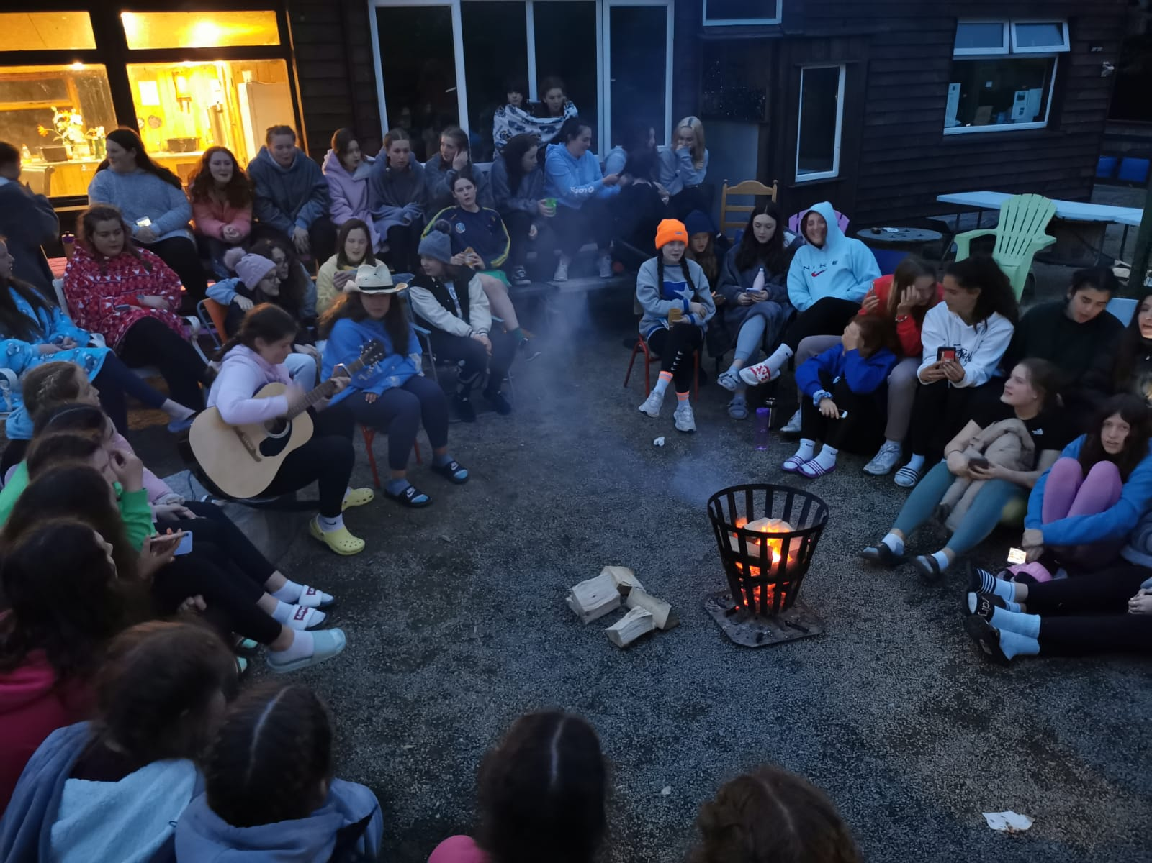
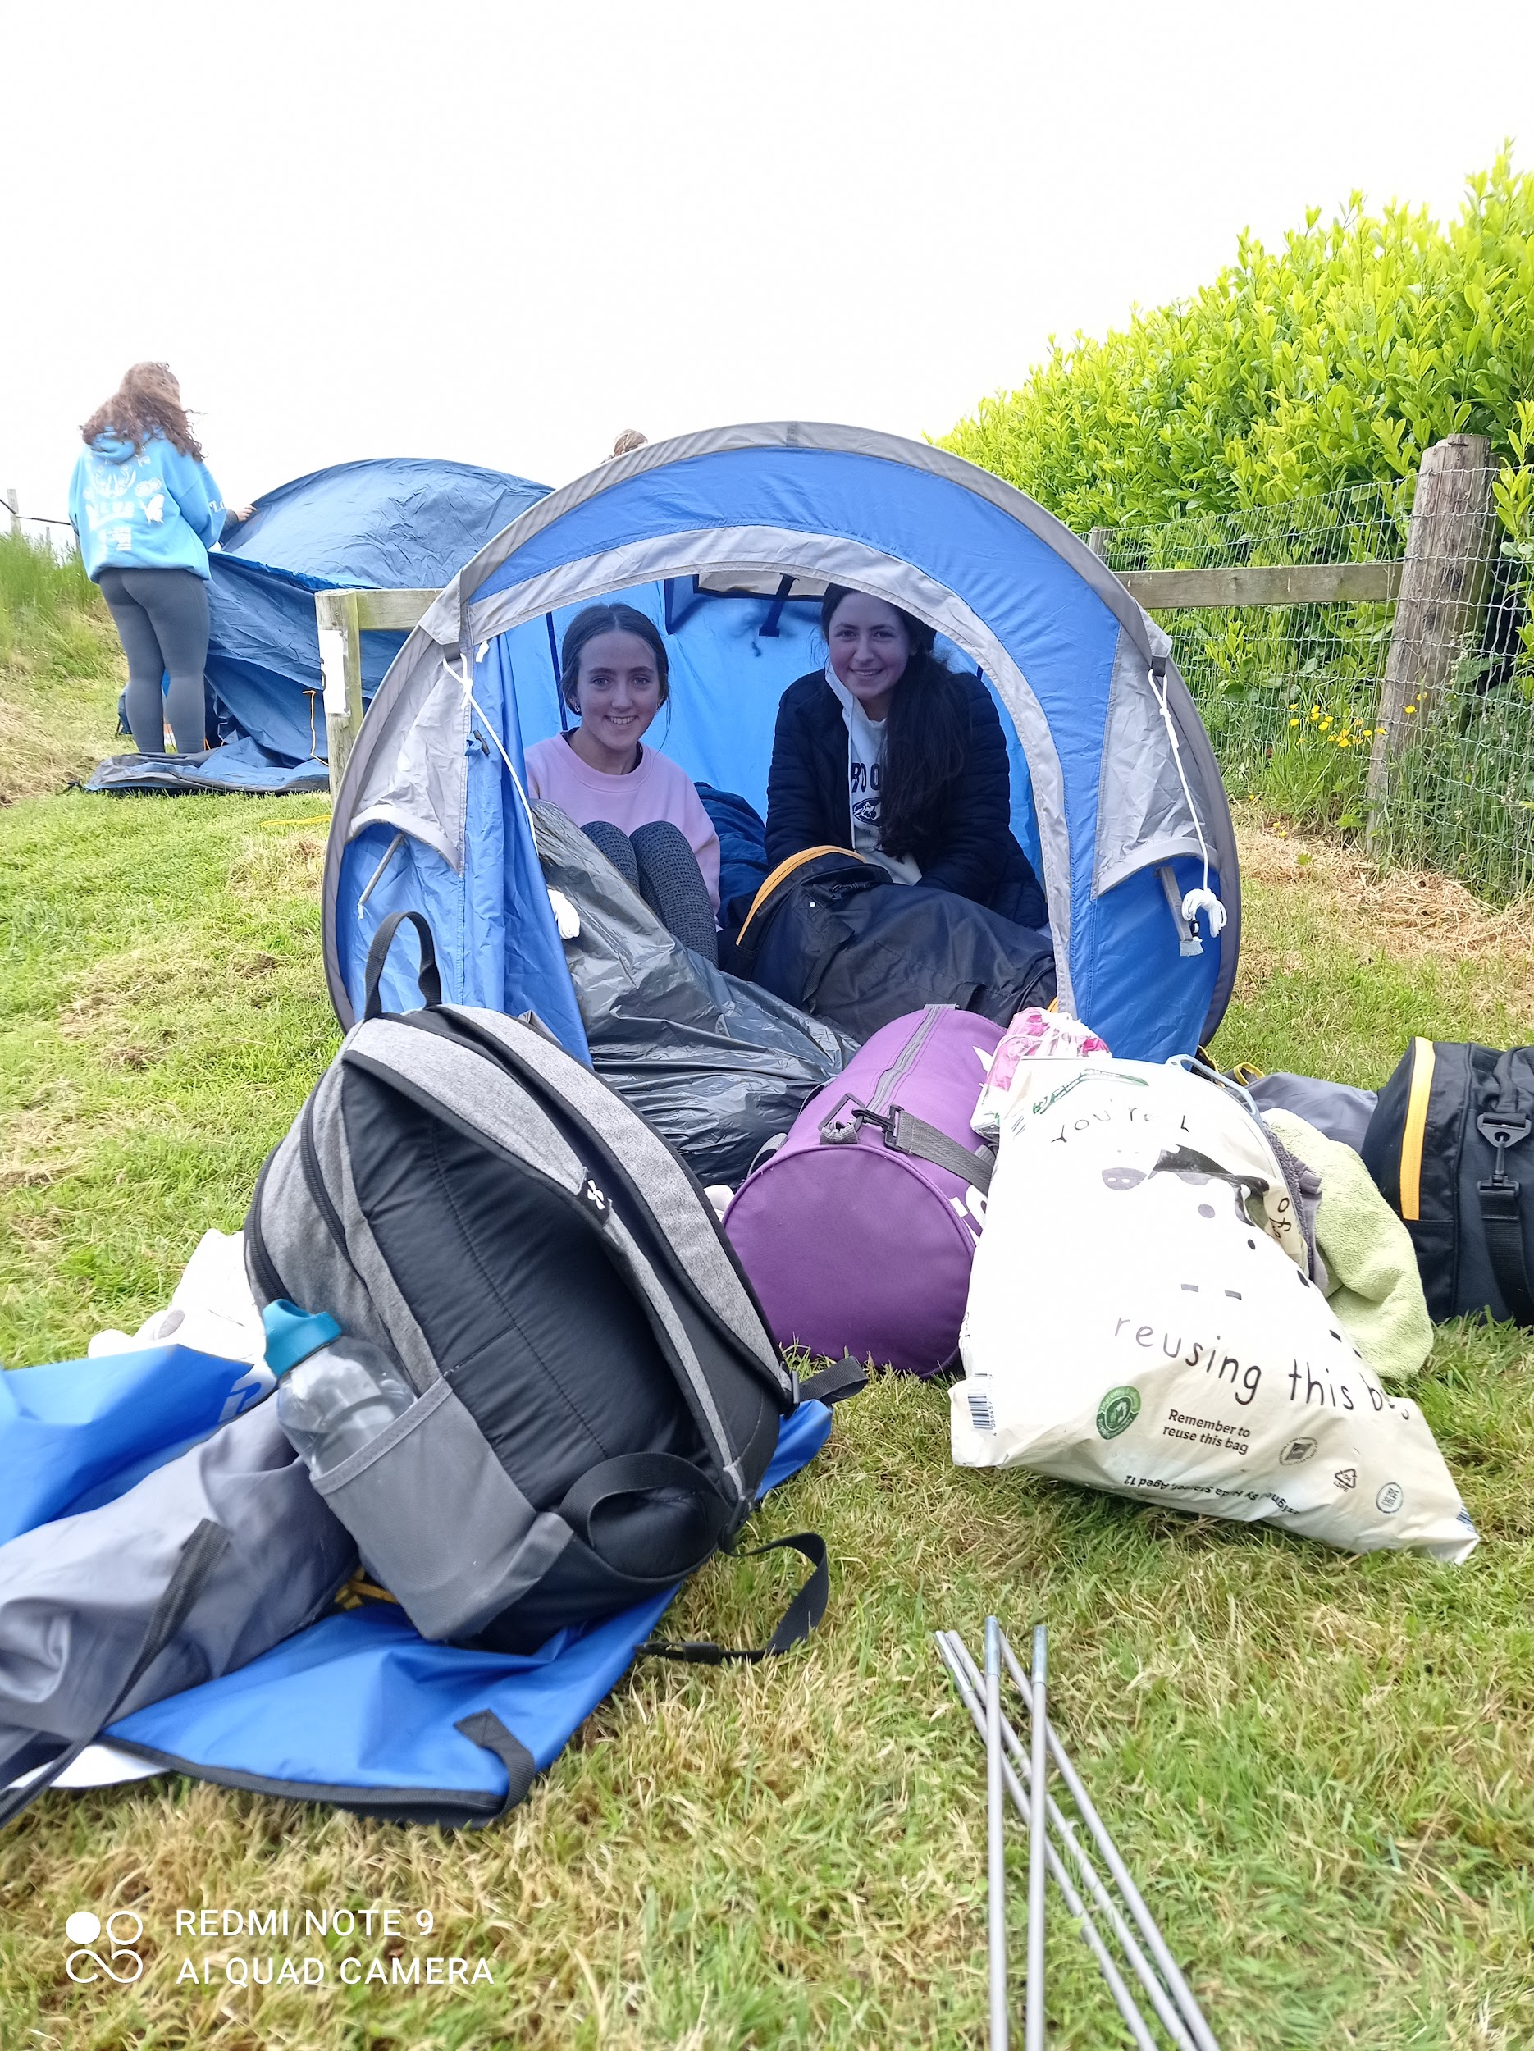
Camping Trip
“It was such a brilliant way to finish the year”
“The festival on the final night was the highlight for me!”
“I feel that the trip brought us so much closer together as a group”
“Seeing the sunrise on top of Mt Brandon was such an amazing experience!”
Sept ‘24
2 nights, 3 days
Brandon Hill Campsite and Scouts Den Graiguenamanagh
Kayaking
Hill walks
Campfire
Festival with live Music and much more

Slide 12
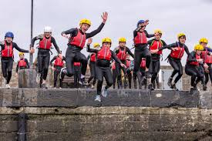
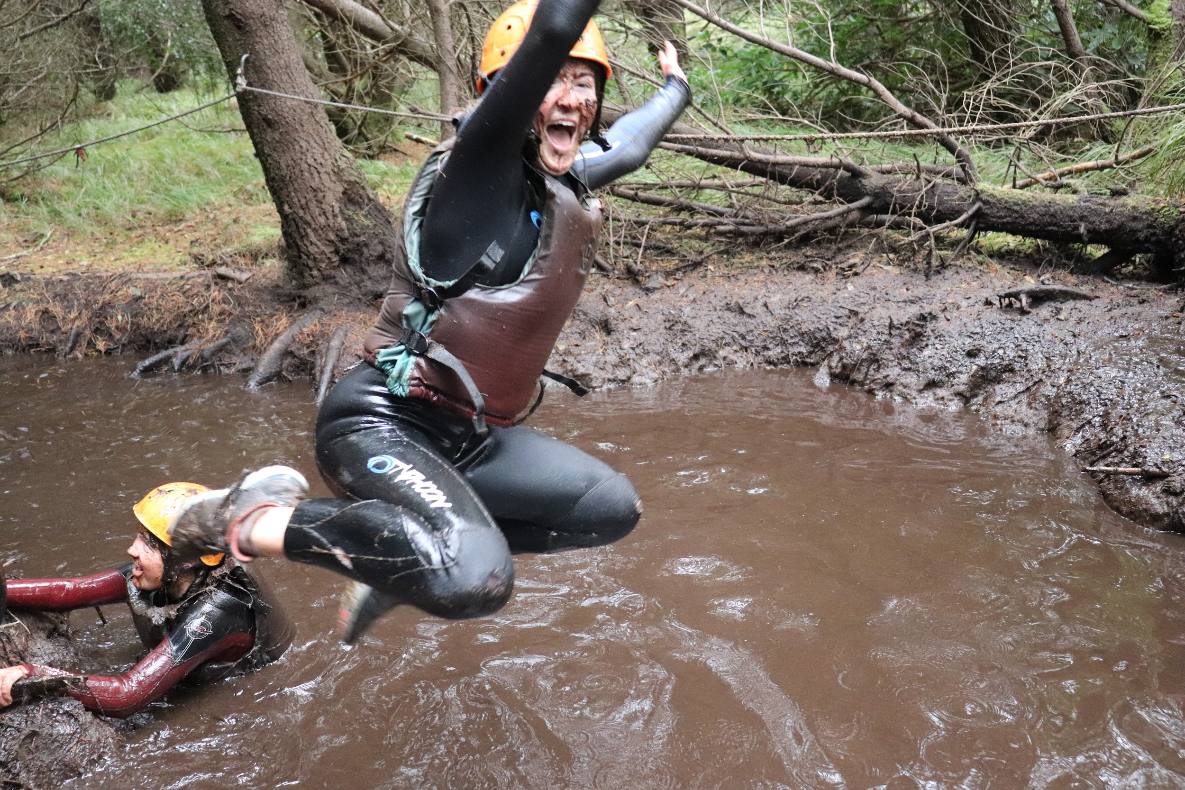
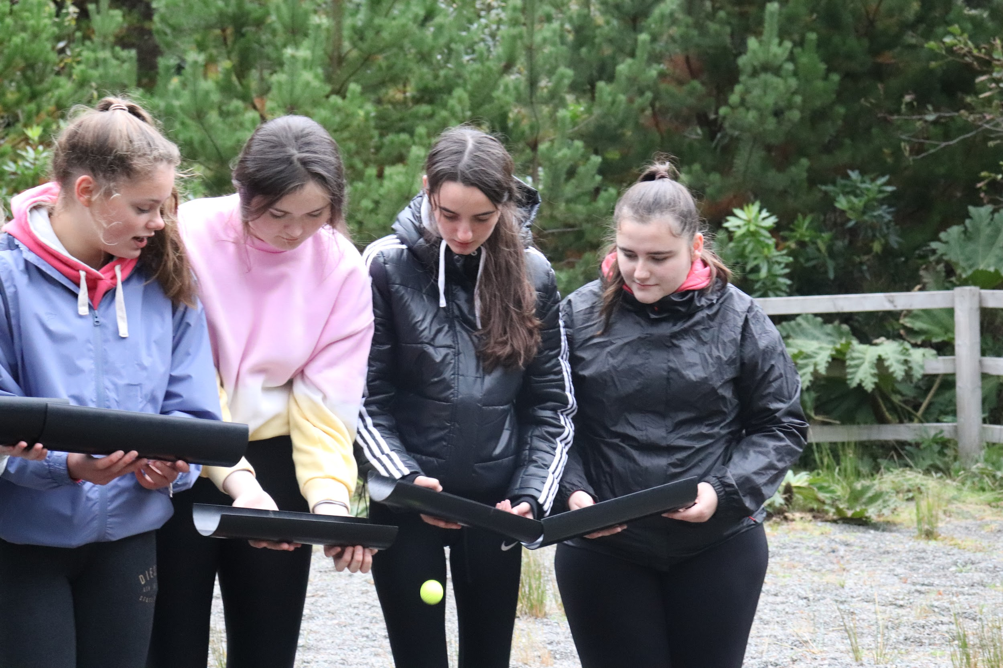
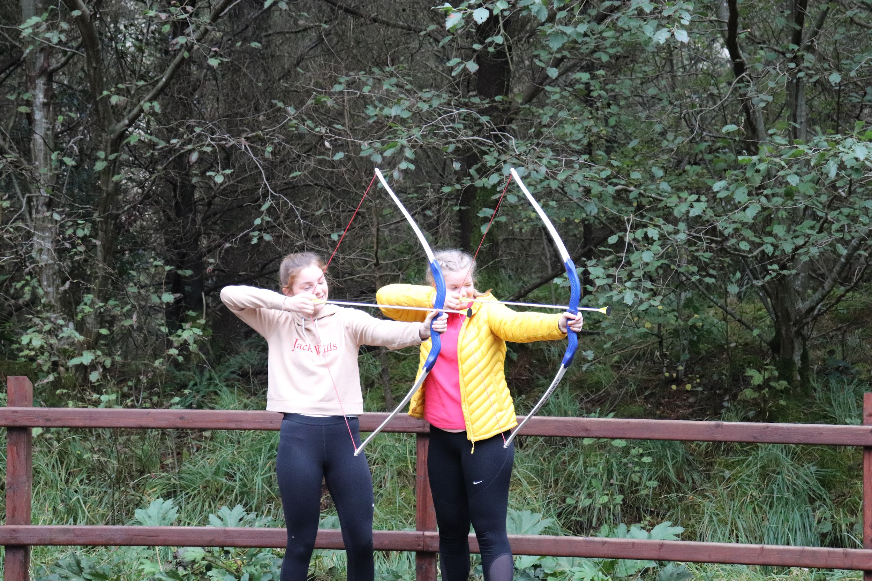
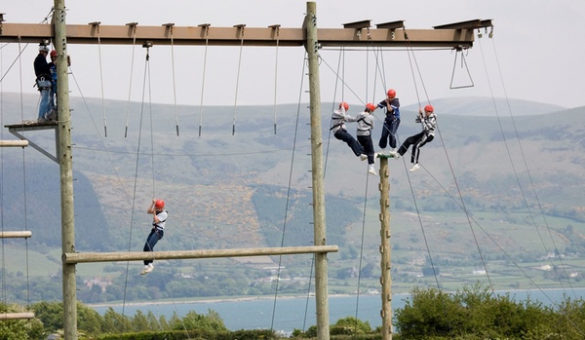
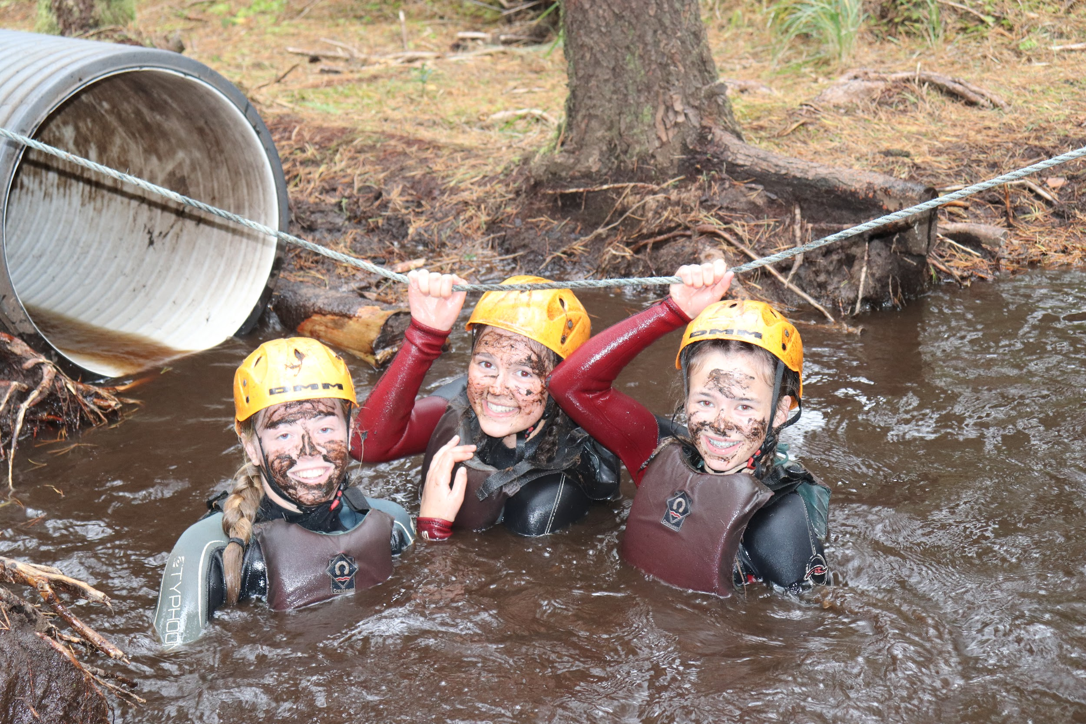
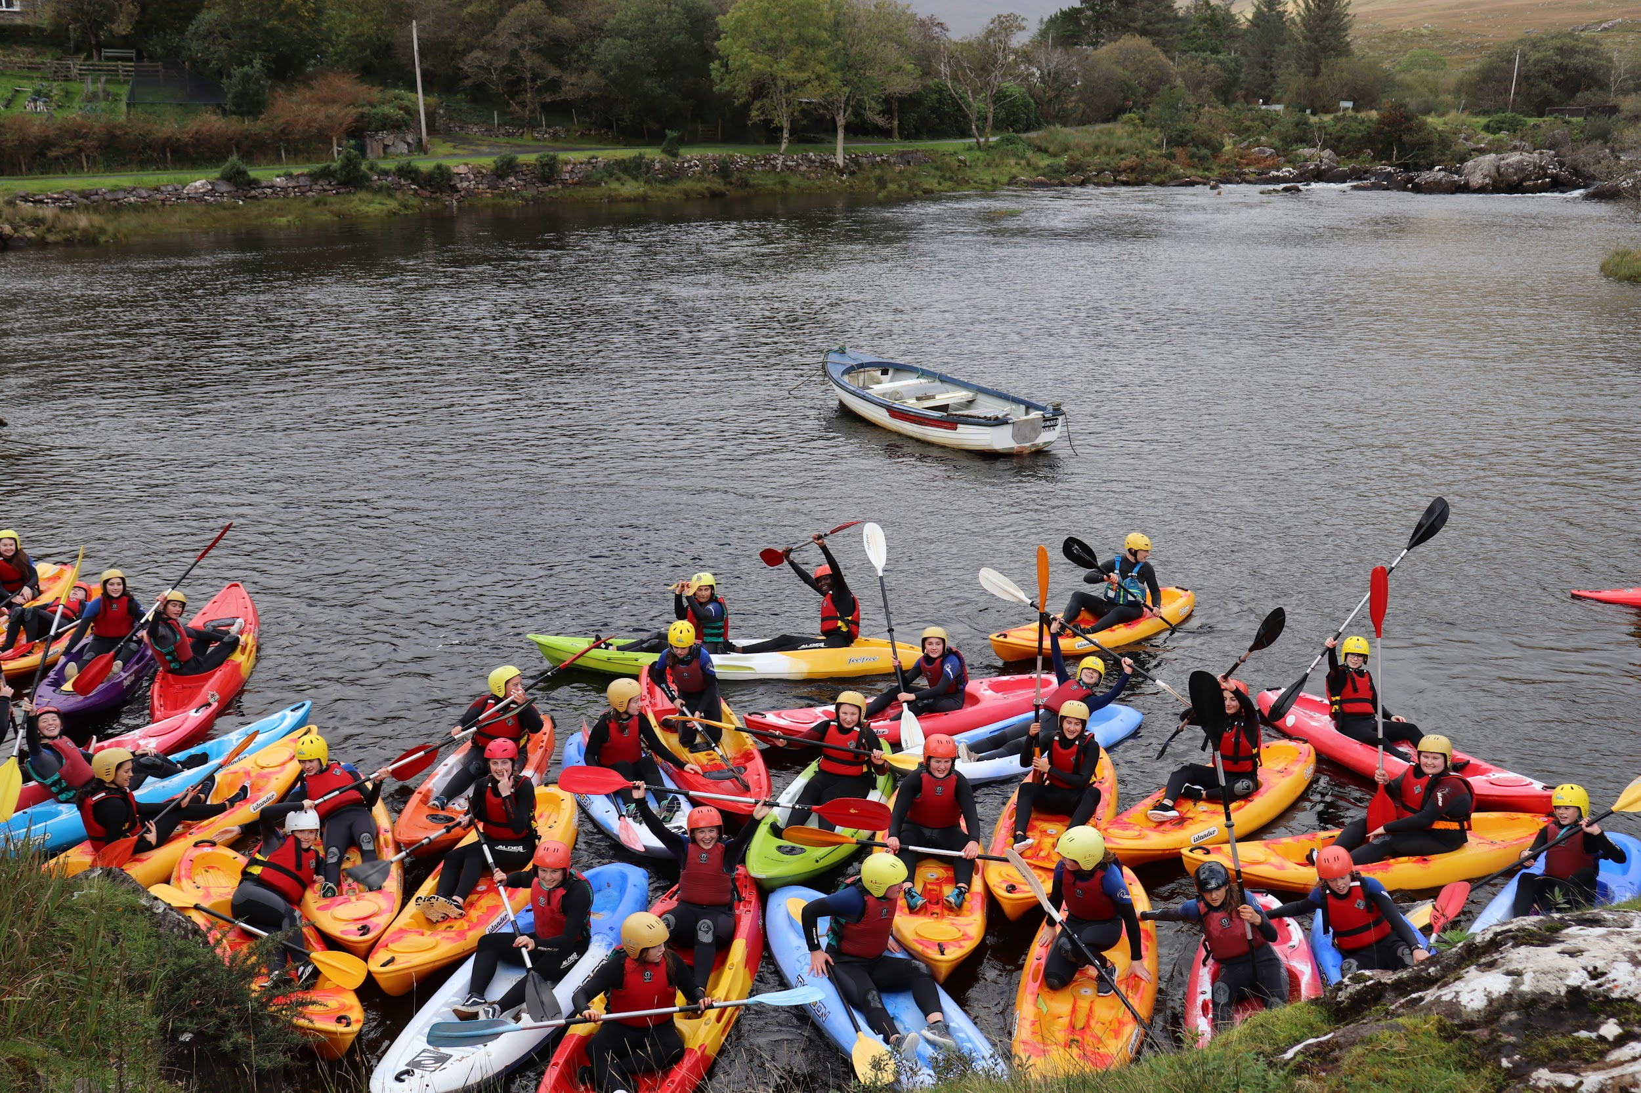
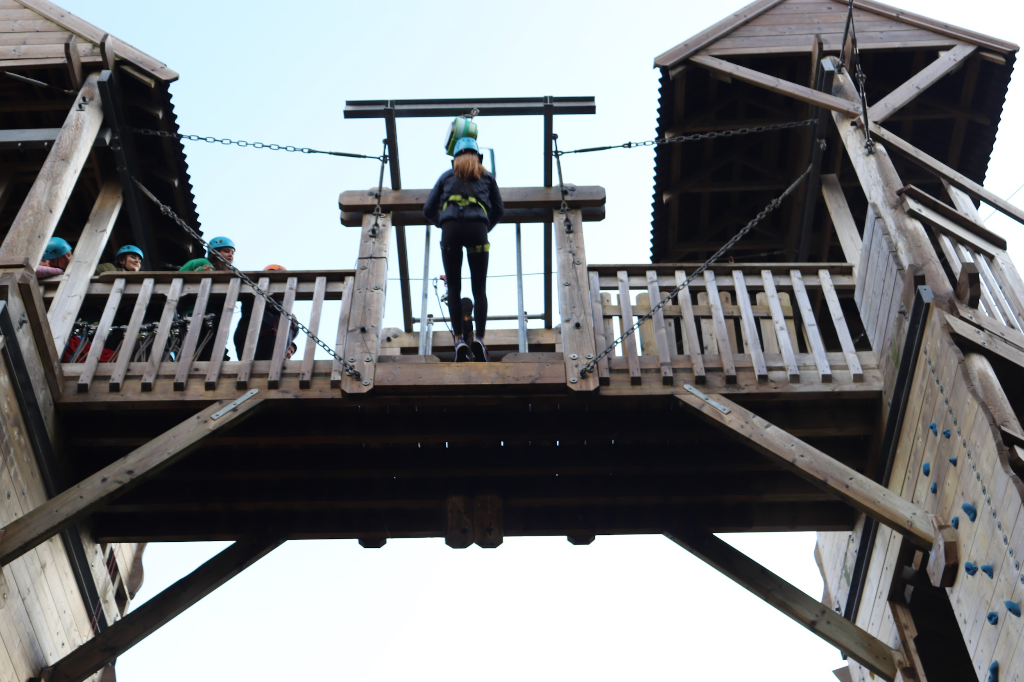
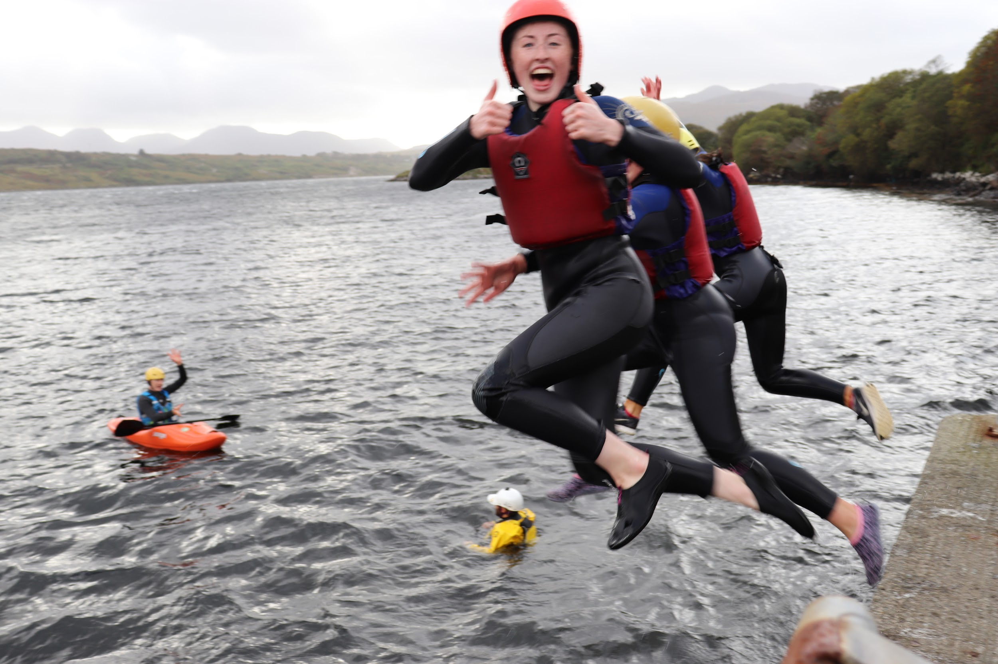
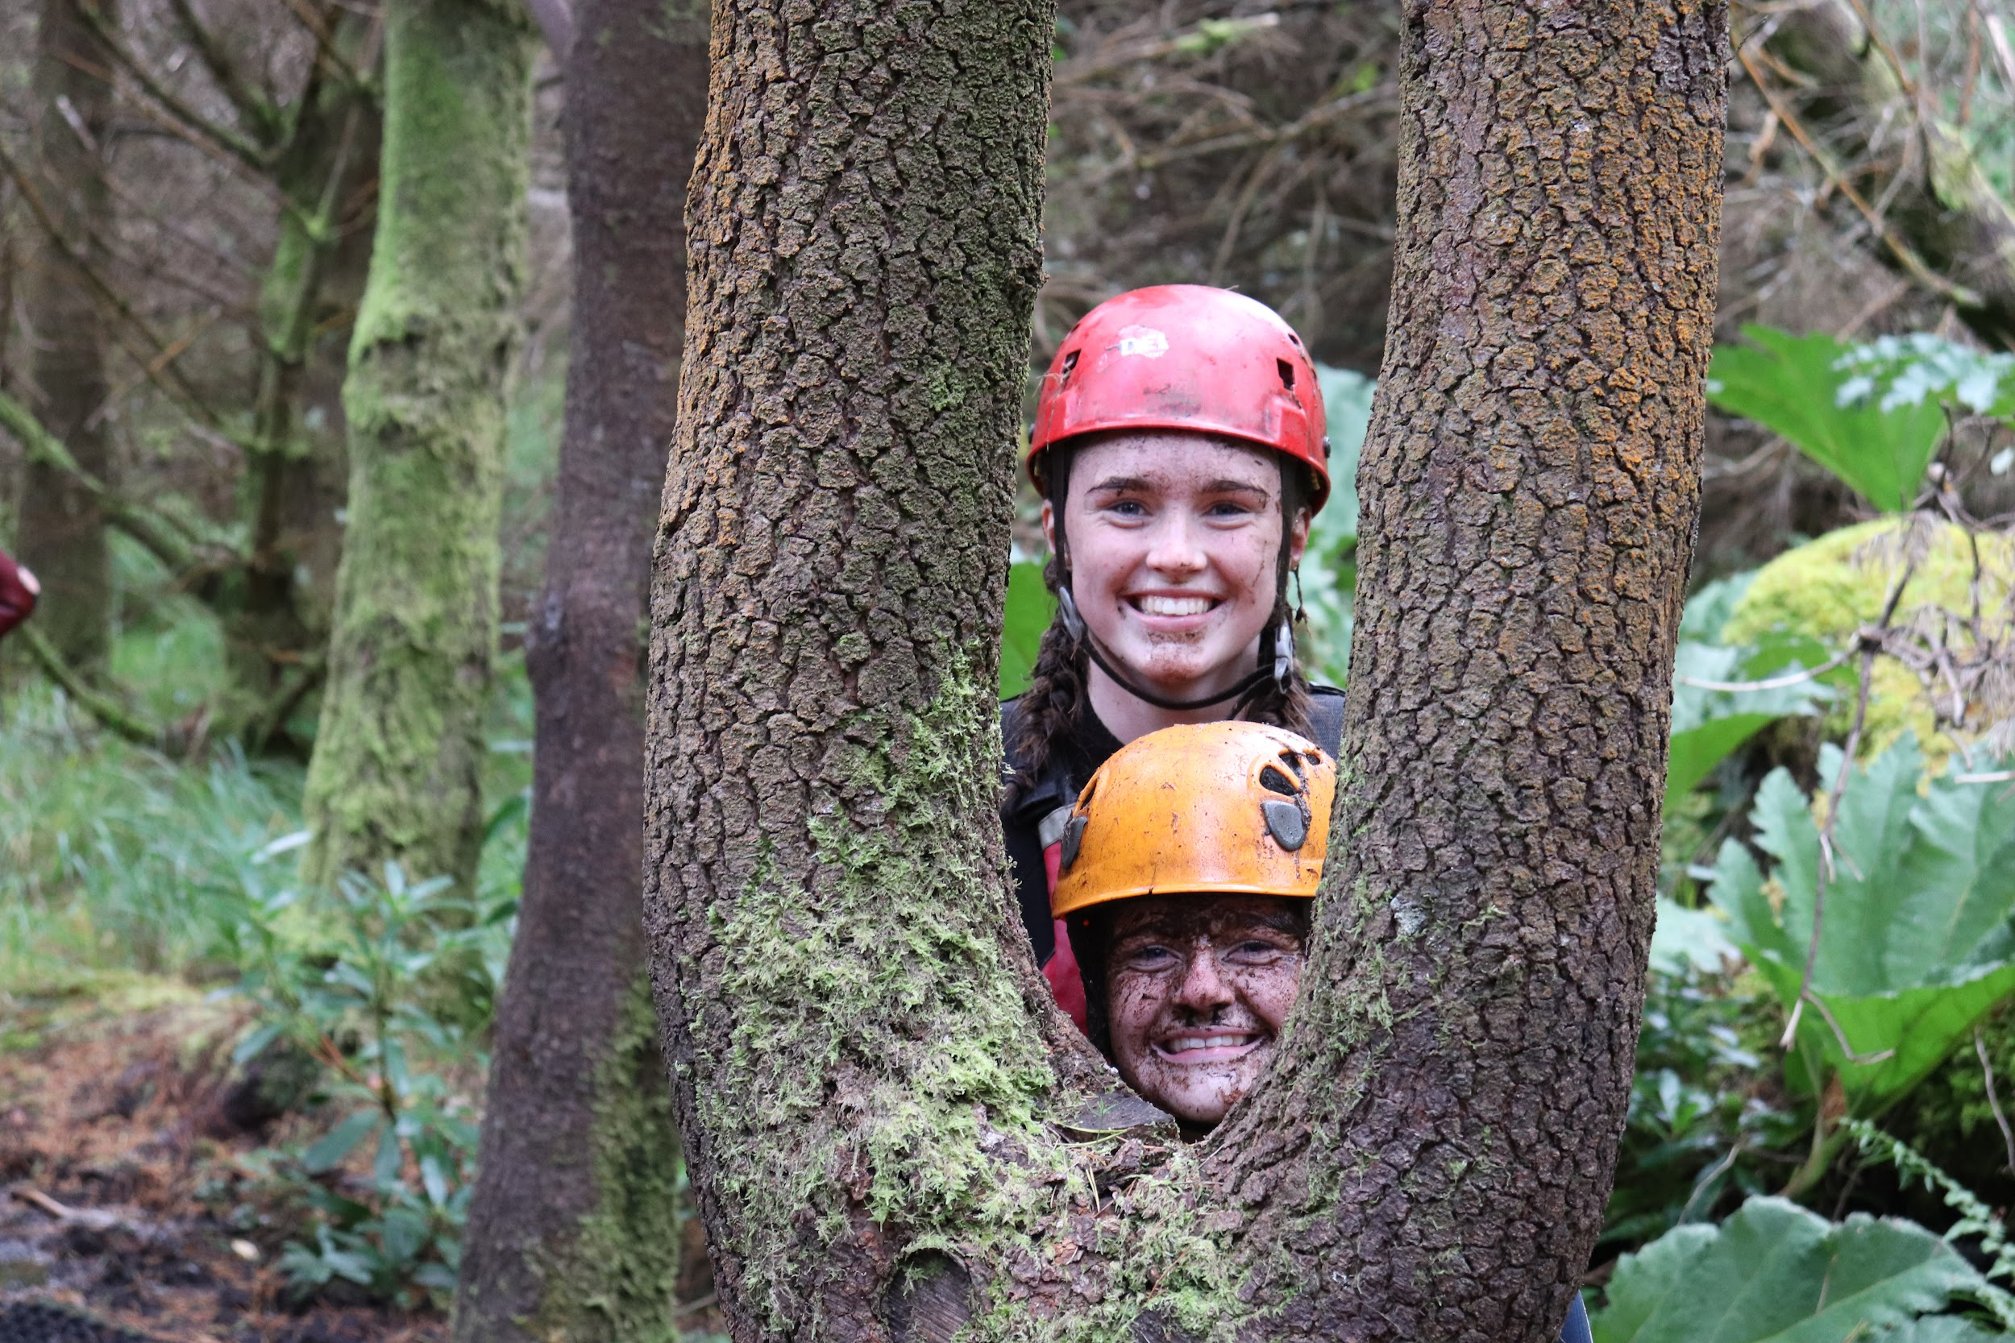
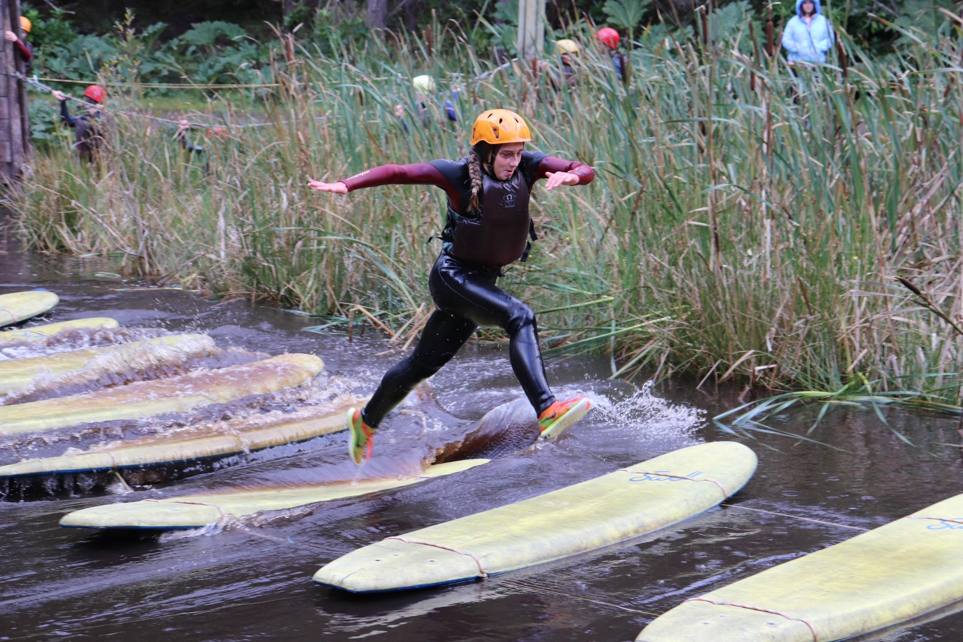
Carlingford Adventure Centre
“I got out of my comfort zone and spoke to people I wouldn’t usually talk to!”
“The activities were so much fun and I’d never get the chance to do them again!”
“It was one of the best trips I’ve ever been on!”
20th - 22nd May ‘25
3 days, 2 nights
Adventure Centre in Carlingford, Co Louth
Full board
Activities include Archery, Kayaking, Pier jumping, rafting, rock climbing, zip-lining, energizers, bush skills, campfire and much more

Slide 13
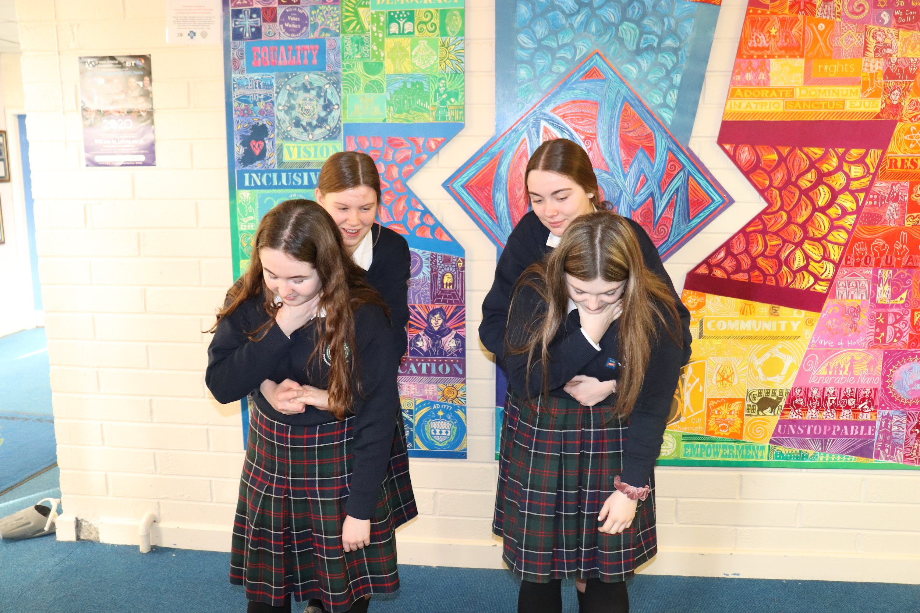
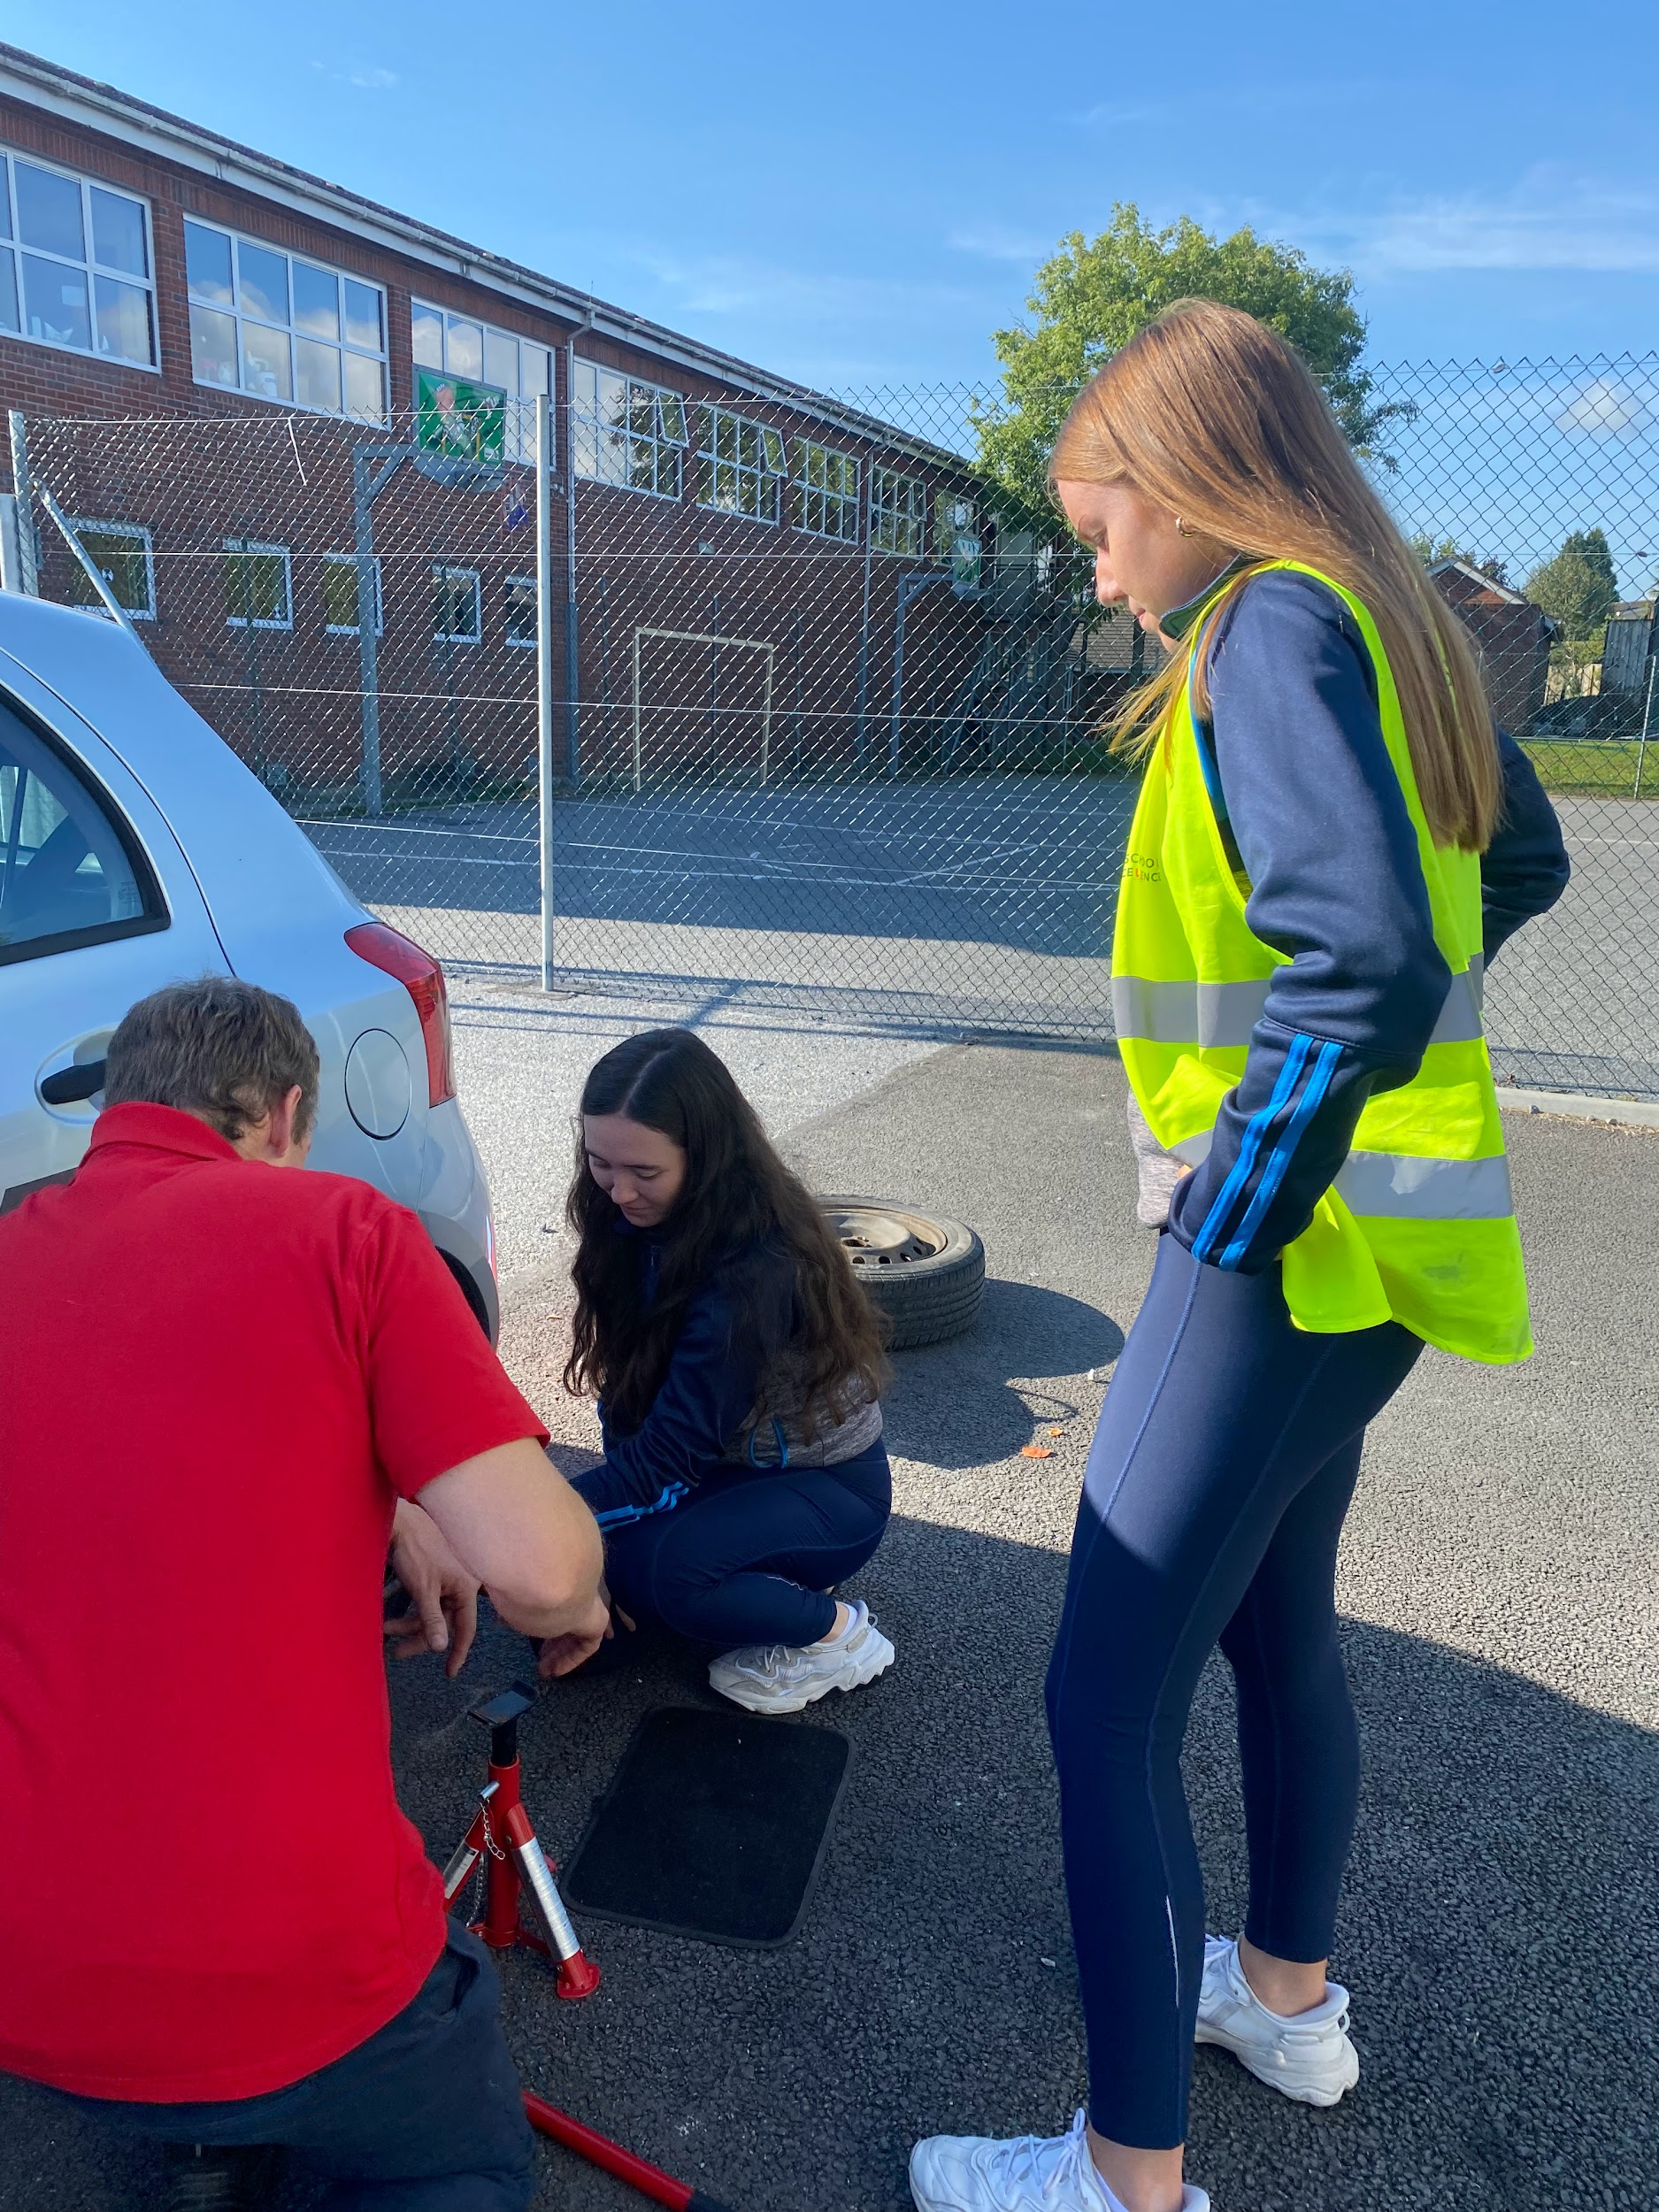
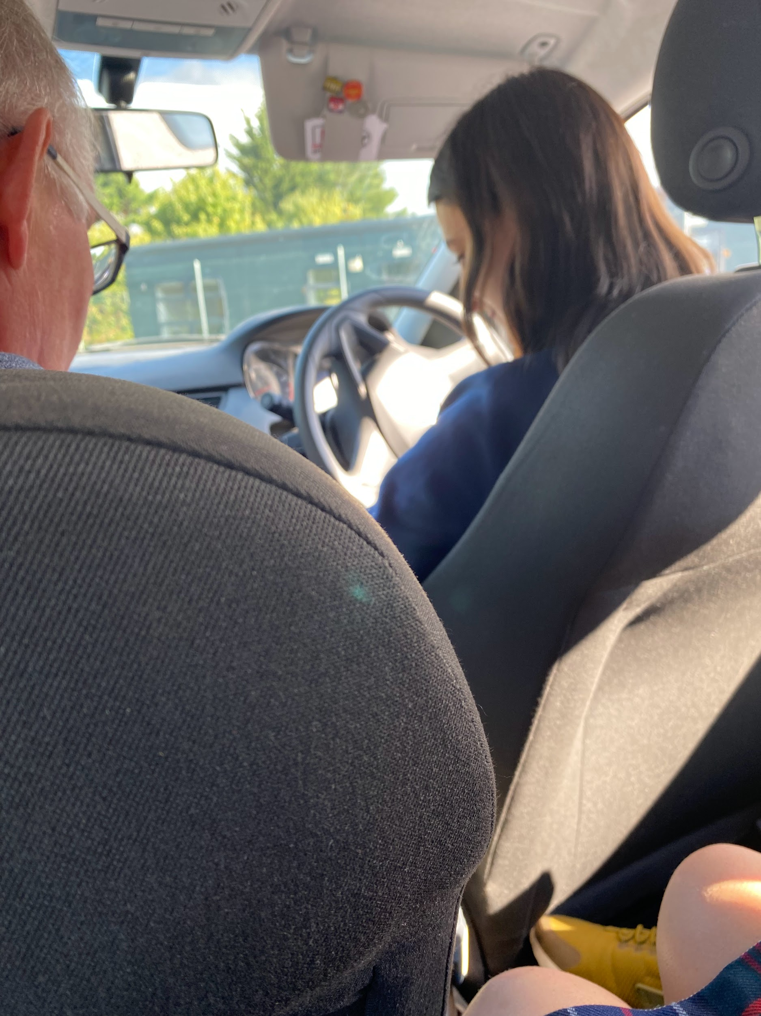
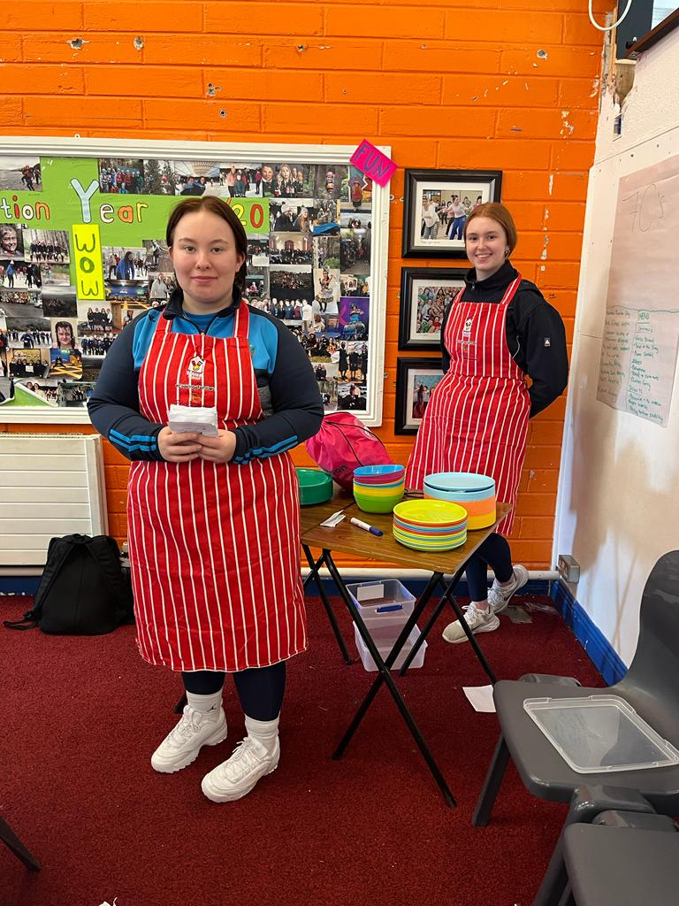
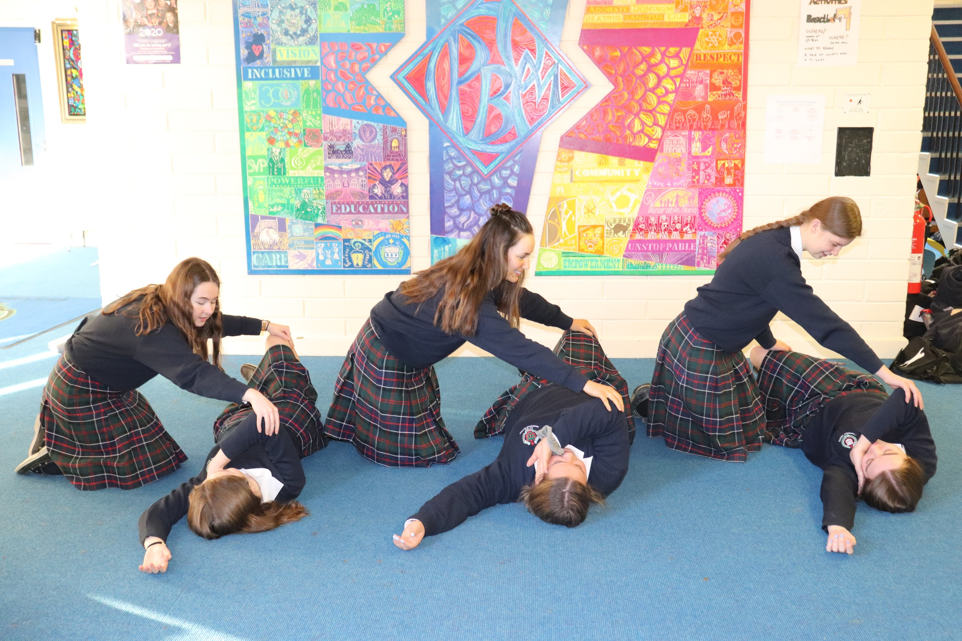
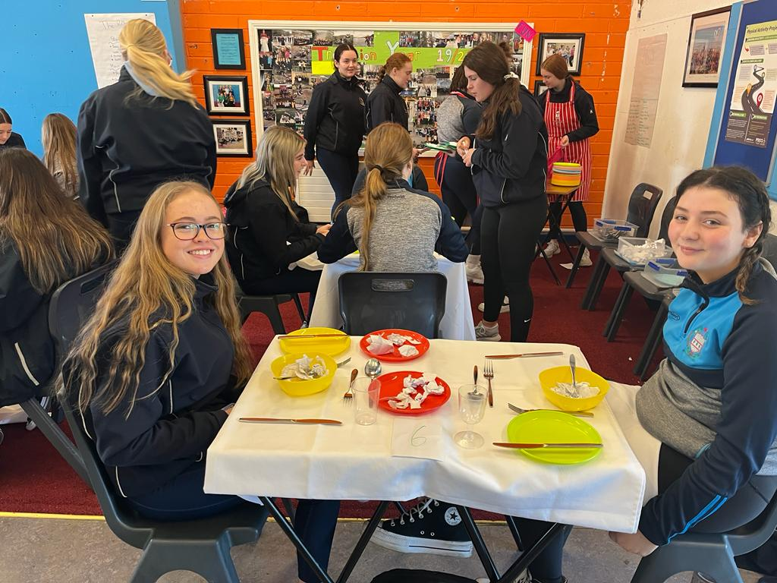
Certified Workshops
First Aid Course
Irish School of Excellence - Driver’s Ed
Barista Course
Lift Programme

Slide 14
Other Transition Year Activities 2023/2024
Fota Wildlife Park | Cycle Champions | Work Experience | Taekwondo
Ploughing Championships | Forensic Science | Sci-Fest | SVP Conference
Ice Skating | Women in Technology | Tayto Park | Retreat
Mini Med Programme | Architects Workshop | GAA Coaching Course | Interview Prep and Interviews
Lift Programme | Subject Option Talks | Law Trip | Comedy Show
Careers Fair | Comedy Show | Tag Rugby | Christmas Wreath Making
French Delf | KASA Workshop | Musical | Make-up Course

Slide 15
COMMUNITY COACHING/ VOLUNTEERING
Cycle champions
VAI primary schools coaching
Weightlifting Ireland
Rowing Ireland
GAA Future Leaders
Green Schools
St Vincent De Paul
Peer pals leadership programme
Older adult exercise classes
KRSP - Supported swim lessons
Science week, Maths week etc

Slide 16
Work Experience

Slide 17
Work Experience
Aims:
Students should sample a variety of actual, real-life working environments.
Students should benefit from the guidance and mentoring of those who hold full time employment in the workplace.
Work Experience should help students make an informed decision regarding subject choices in light of a future career.
Students should improve communication, life and social skills while in the process of acquiring work experience, in addition to the placement itself.
*Different employer required for each placement*
*Acquiring WE is the responsibility of the student*
*Garda vetting*
Block | Date
1 | October
2 | March

Slide 18
Other Work Experience Opportunities
St Luke’s Hospital Nursing Day, Pharmacy Day, Physio Day
Waterford Regional Hospital - mini med Programme
Clunetech TY Programme

Slide 19
Assessment

Slide 20
Assessment
Continuous Assessment
Christmas Report
Timetabled exams in core subjects
Summer Report
Timetabled exams in core subjects
Portfolio of Achievement
Samples of excellence & reflections on experiences
Certs
Photos
Interview
End of year based on participation & experiences gained from the year
Continuous Assessment
Formative Assessment
Summative Assessment

Slide 21
Credit System
Credits will be awarded in each subject
Credits will also be awarded for Attendance, Punctuality, Eportfolio and Interview
Distinction
Merit
Pass
No Grade

Slide 22
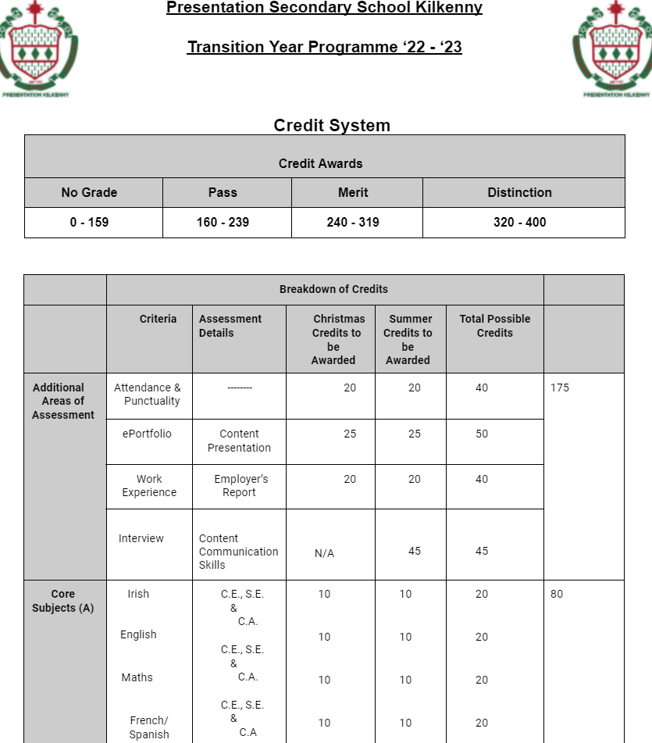

Slide 23
Programme Fees

Slide 24
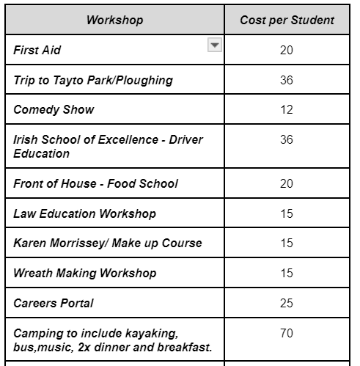
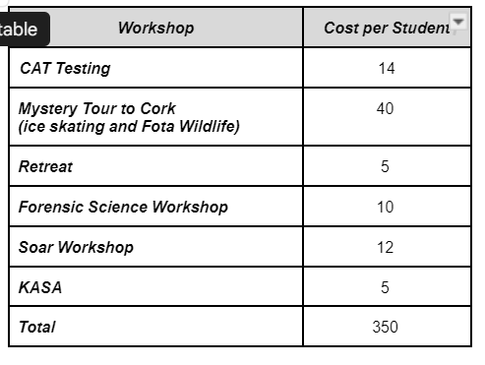
TY Programme Fee (not including Carlingford Trip) €350
Sample of Activities
Additional Activities = Additional Cost

Slide 25
Fee Payment
Payment Collection | Payment Date | Payment Amount
Deposit | Fri 10th May ‘24 | €200
Final Installment | Aug ‘24 | €150
Installments

Slide 26
Carlingford Trip Fee
Payment Date | Payment Amount
31st January ‘25 | €250
Payment Collection
Payment
Date
Payment Amount
Full payment paid by end of January

Slide 27
Acceptance
Criteria
Attendance
Behaviour
Application to previous studies (1st, 2nd & 3rd Year)
Acceptance is at the discretion of Management.

Slide 28
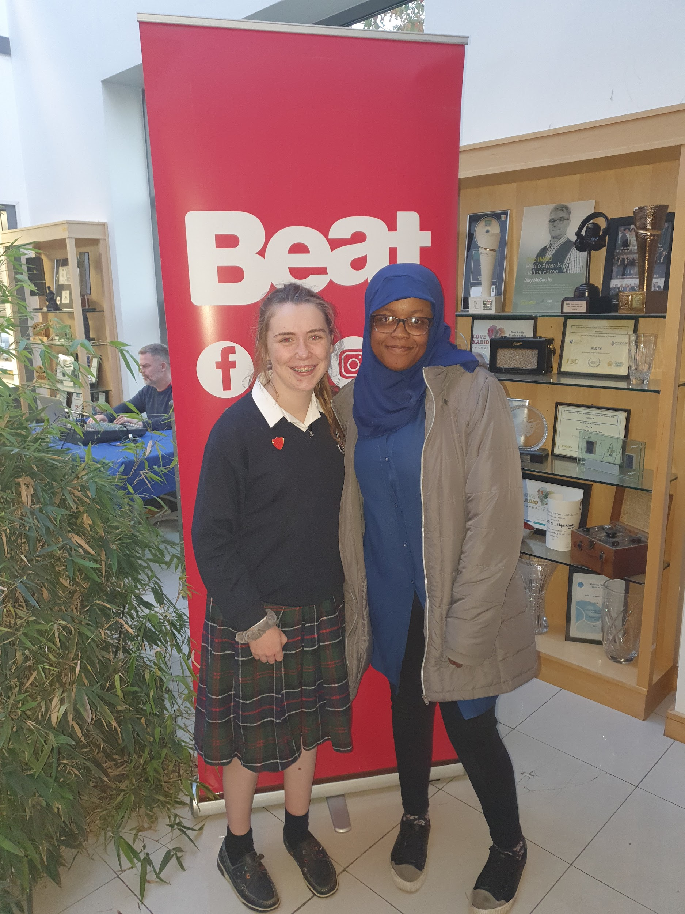
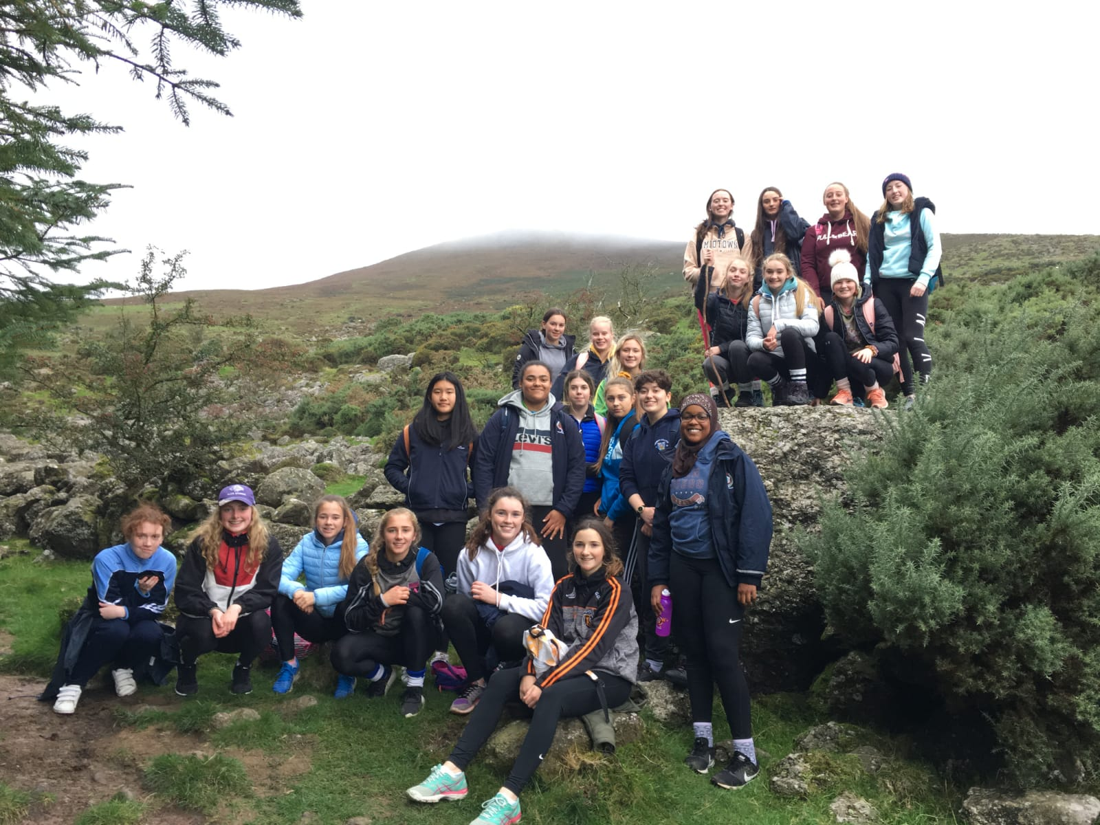
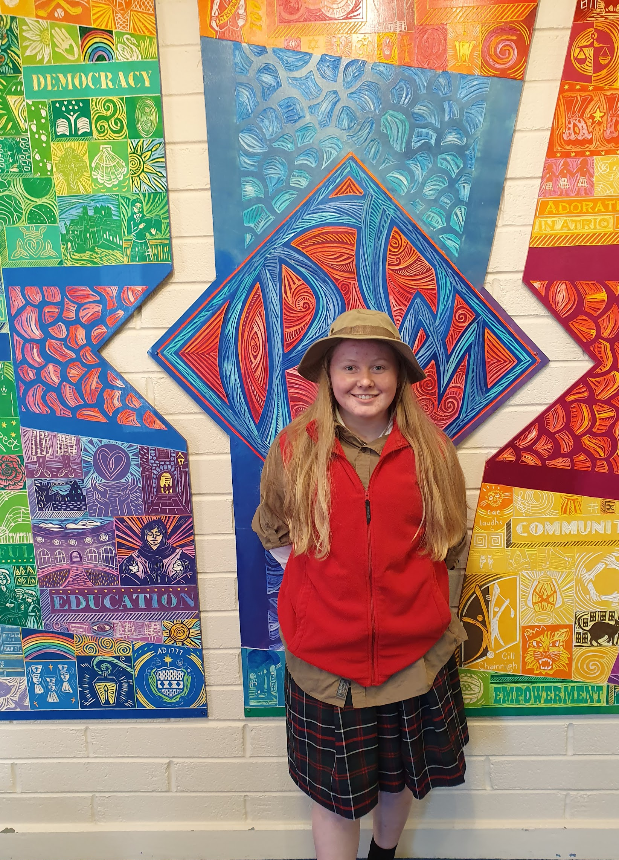
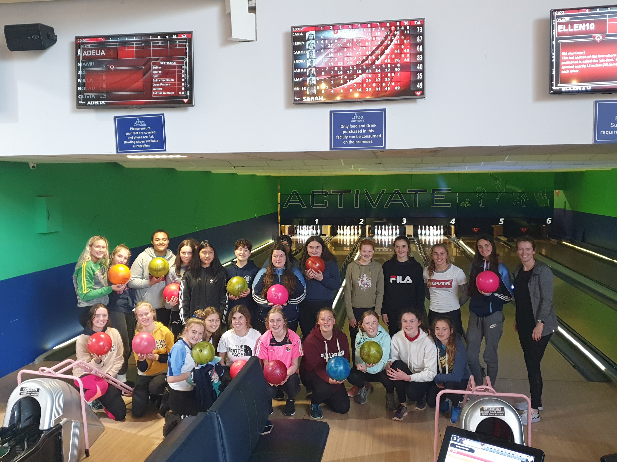
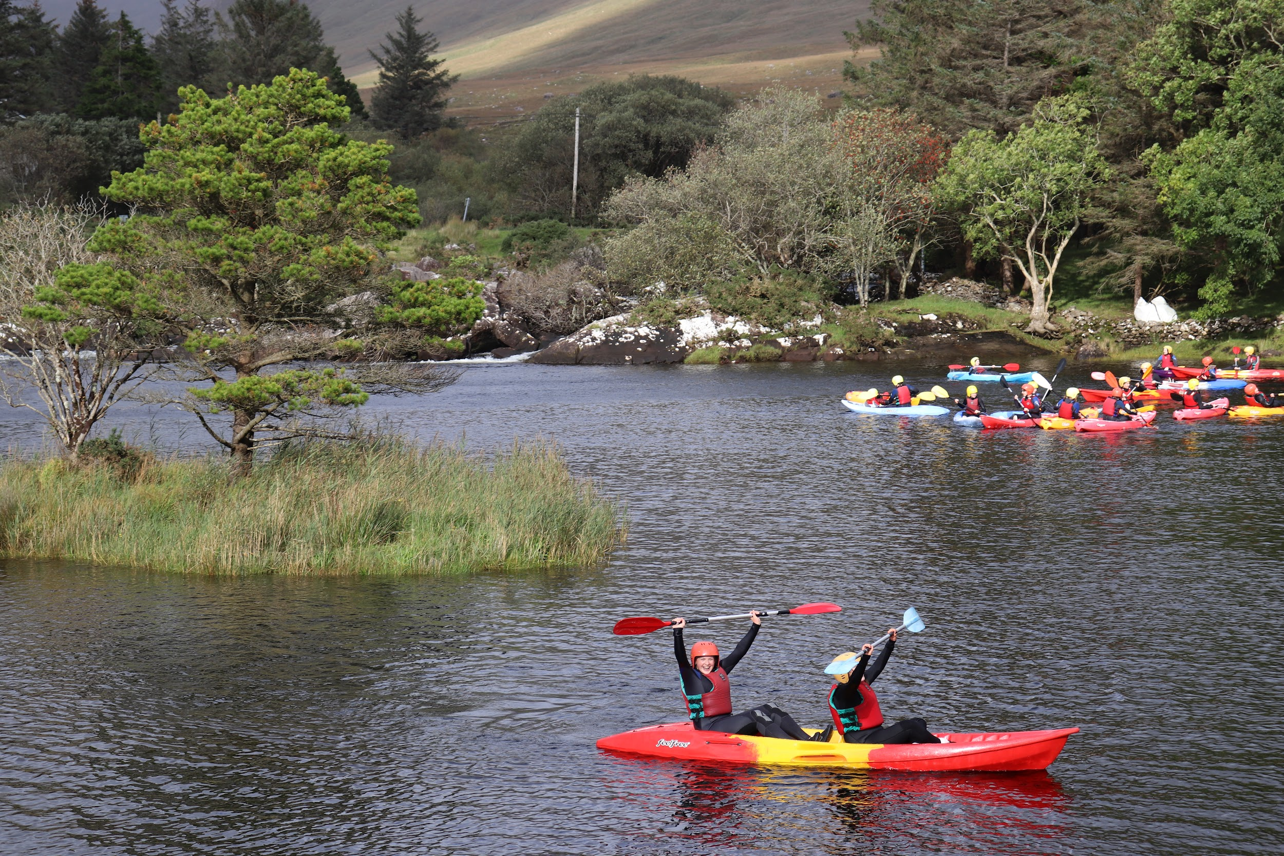
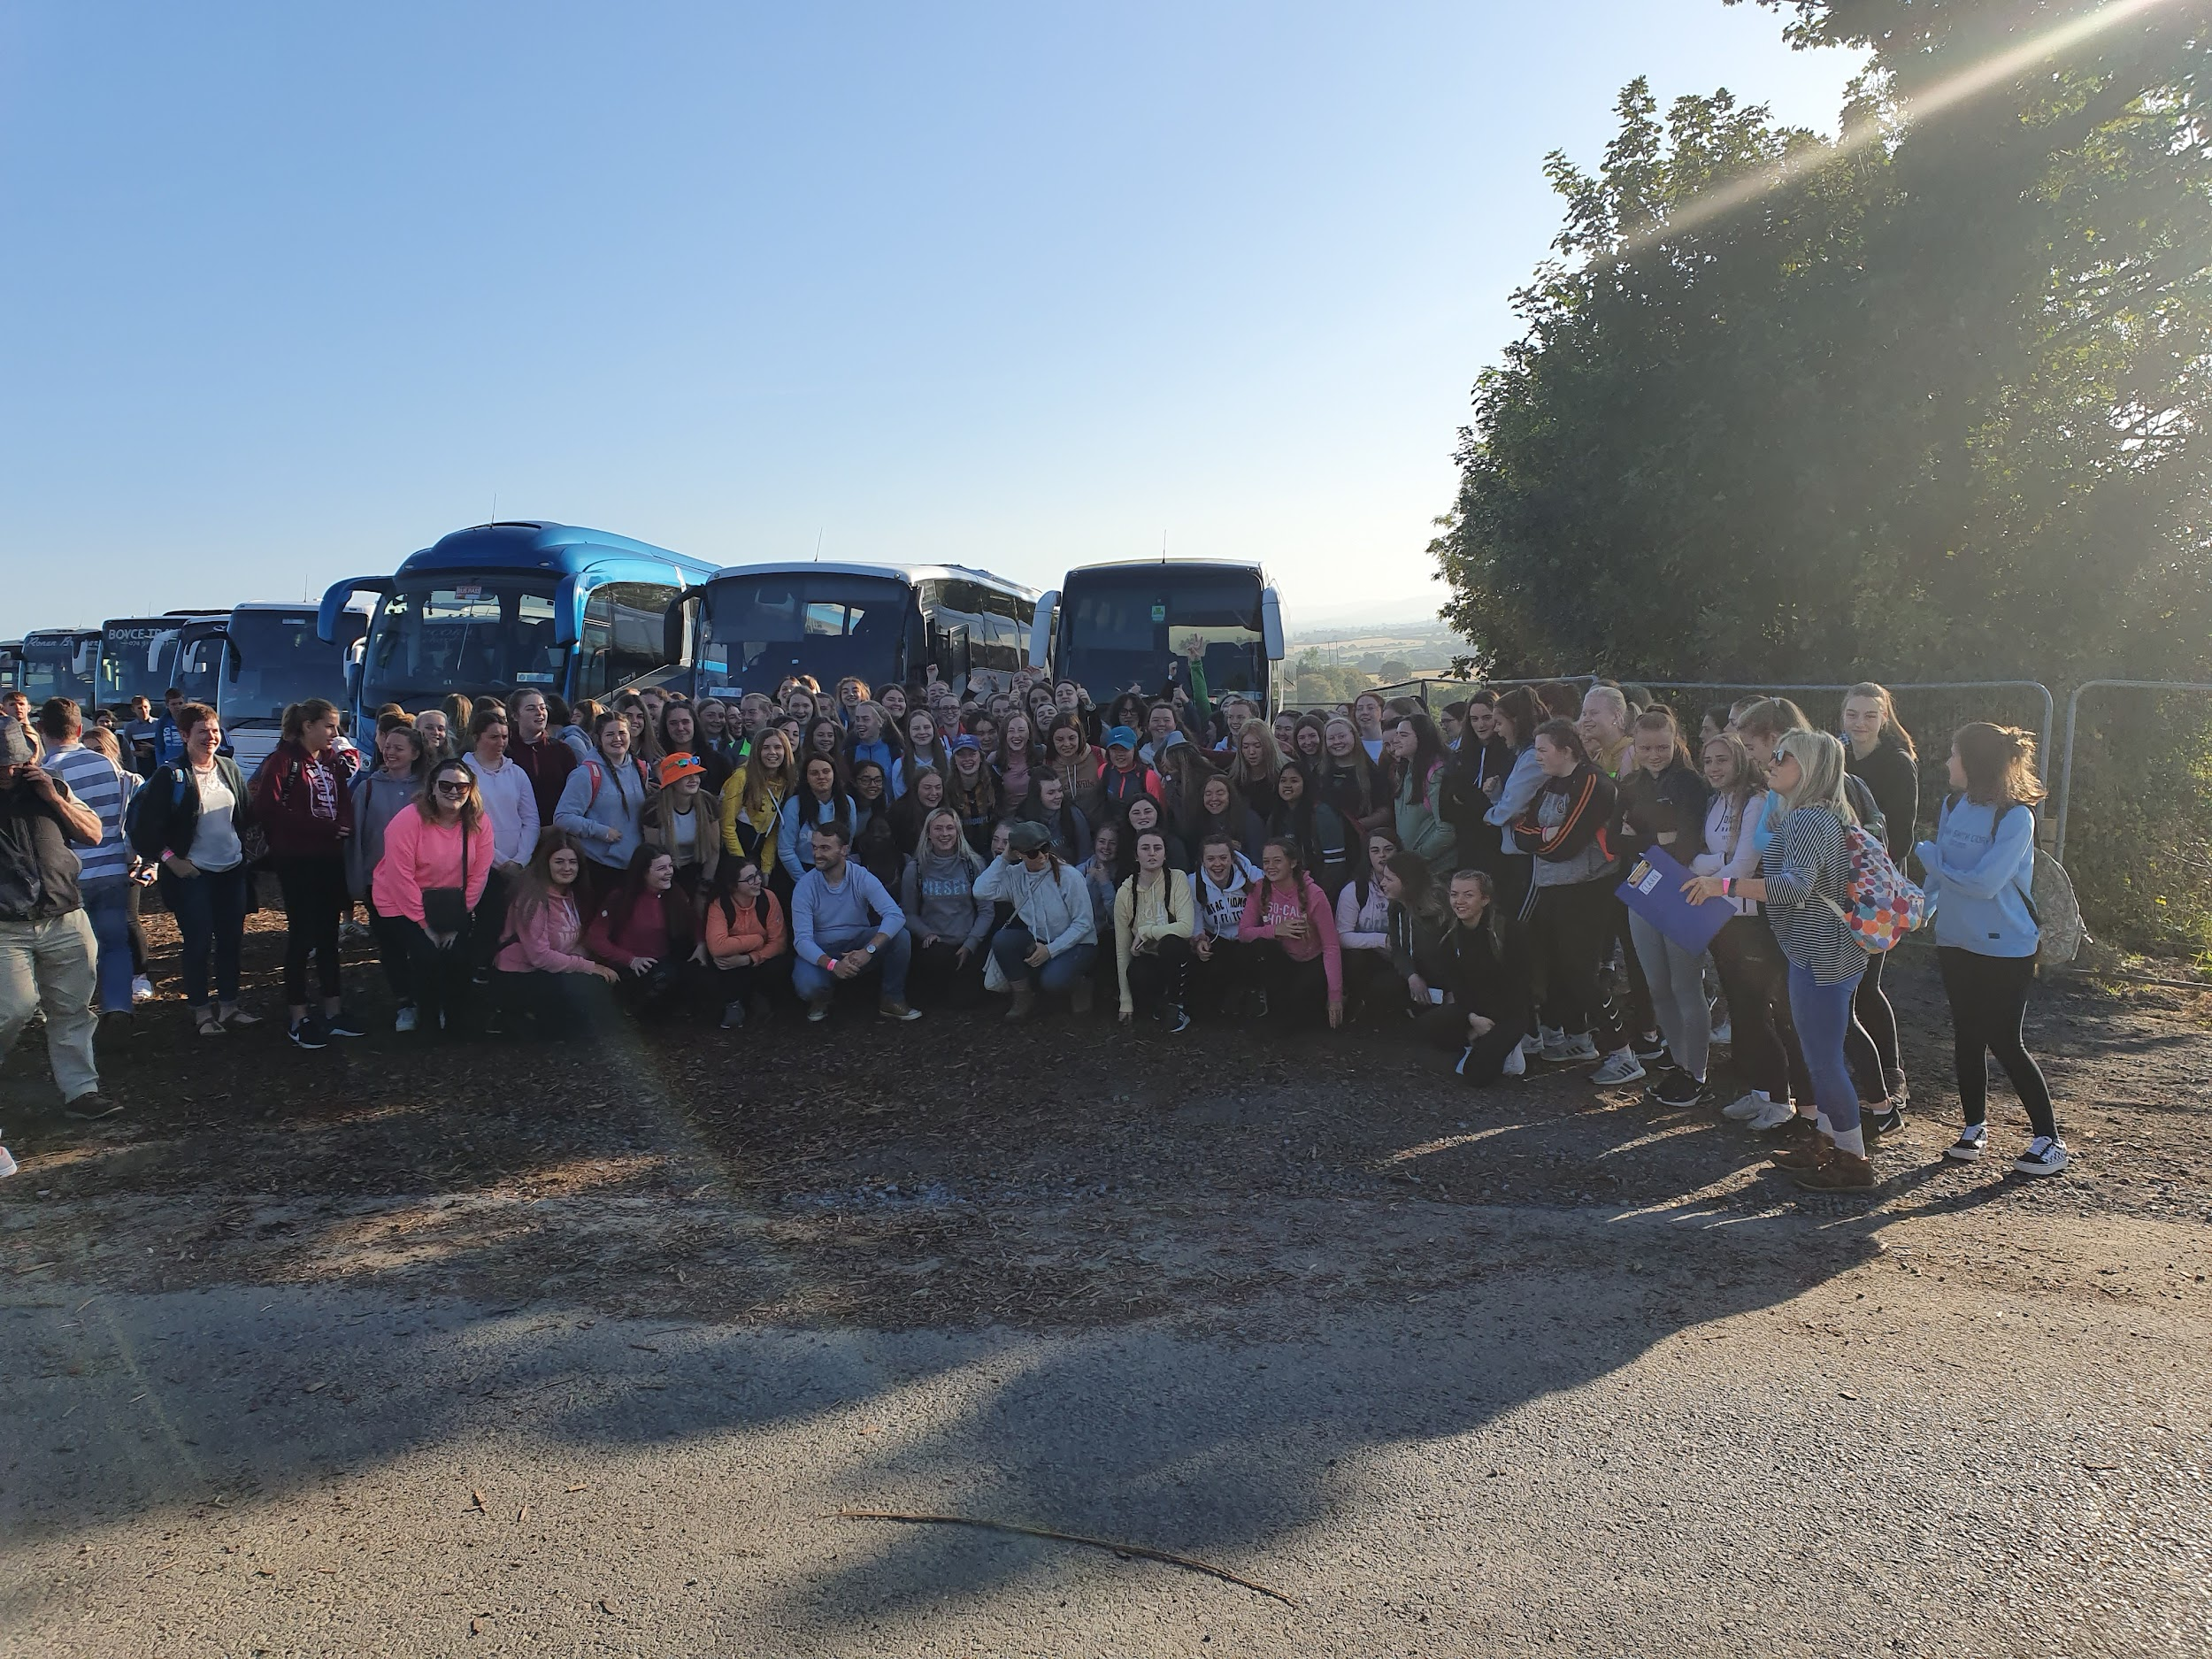
A form will be distributed in class that must be completed and handed into the school office.
HOW TO APPLY...

Slide 29
Now let’s listen to the opinion of a former TY student...

Slide 30
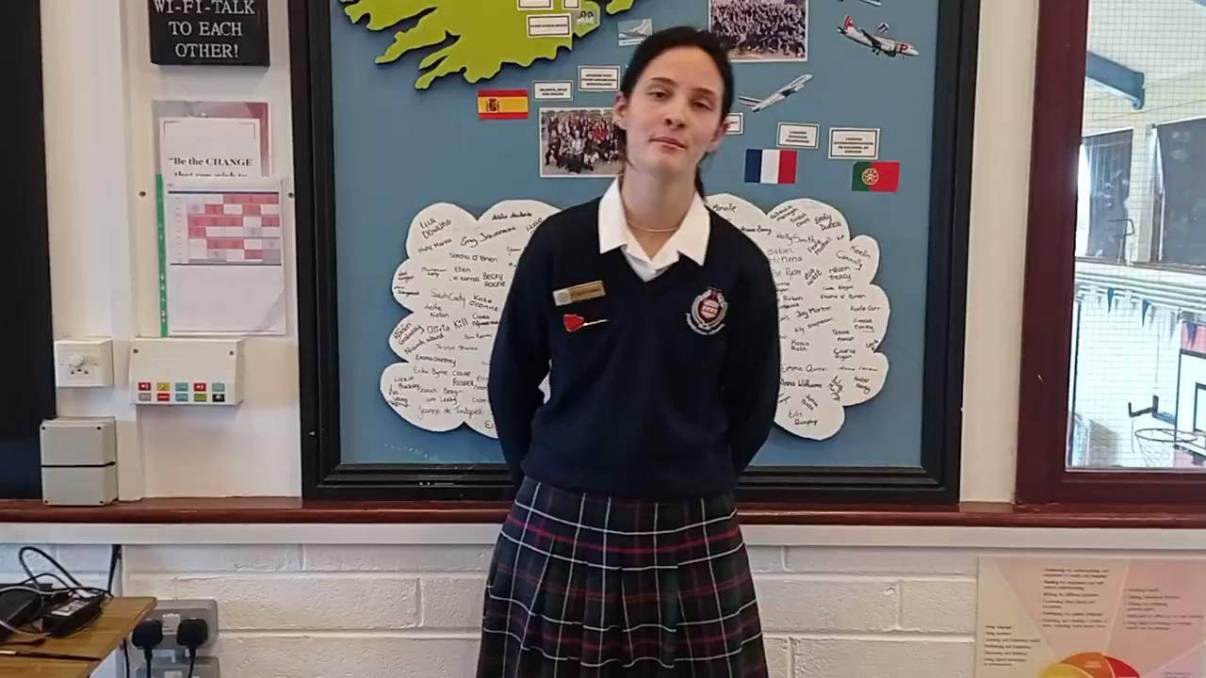

Slide 31
Now some of our current TY students...

Slide 32
https://drive.google.com/file/d/1dTPFG6VOpt9GYJlTWqK38a59ifqBECAB/view?ts=65df5420

Slide 33
Questions?

Slide 34
THANK YOU FOR LISTENING!

